Slide 1
Hashing
CS3323

Slide 2
Hashing Approaches
Chaining
Linear Probing
Quadratic Probing
Double Hashing

Slide 3
Some Application Areas
Compilers
    Symbol tables
Gaming
    Store positions, configurations, state info. etc.
Spell checking
    Pre-hash entire dictionary
Database
    Keyed indices for retrieval of large amounts of data

Slide 4
Hashing
Say we have a company with 100 employees.
  Each employee assigned a 5 digit employee number.
  Range of employee numbers is [0,10⁵-1]
  Efficiency is key issue here
We use N to denote the size of the range used for the Hash Table, and n to denote the size of the data set
  For above scenario:
    N=99999
    n=100

Slide 5
Suboptimal Hashing
Array of N buckets indexed by key
  Search Time: O(1)
  Storage Requirements: O(N)
    Huge amounts of wasted space
Linked List of n elements
  Search and Storage are O(n)
Balanced Binary Tree with n nodes.
  Search: O(logn)
  Storage: O(n)
null
null
null
Mary
Susan
John
Joe
null
00000
00001
00002
…
11254
11255
11256
…
27798
…
99999
Head
Mary
Susan
John
Joe
null
11254
11255
11256
27798

Slide 6
A Better Solution
Hash Tables:
  O(1) search time
  O(N) storage space
    where N is the table size
  Like array implementation but we use a function to map large range into a smaller more manageable one.
  Example function: f(x) = x mod 100
    Maps keys into a relatively small range. Mapped values used as indices, not original keys.

Slide 7
Hashing
Create bucket array of length N, called A
Map hash code ,k , (key value) into range [0,N-1].
Use remainder: f(k) = k mod N
Store item with hashcode k in A at index i=f(k)

Slide 8
Simple Hashing Example
Suppose we use a hashed array with 5 buckets
  Insert (Steve, 99654)
    Calculate hash value = 99654 mod 5 = 4
    Therefore (Steve,99654) is stored in slot indexed by 4
  Insert (Tanya,35562)
    35562 mod 5 = 2
null
null
null
null
null
0
1
2
3
4
null
null
null
null
Steve99654
0
1
2
3
4
null
null
Tanya 35562
null
Steve99654
0
1
2
3
4

Slide 9
Simple Hashing Example
What happens if we get overlap?
  Insert (John, 01197)
    01197 mod 5 = 2
null
null
Tanya 35562
null
Steve99654
0
1
2
3
4

Slide 10
Chaining
If a collision occurs
  two keys map to same slot!
  Chaining
    Use linked lists to hold the elements, and use array indices only to access lists.
    Hash table becomes array of linked lists.
    Only one of the many possible solutions to collision problem
0
1
2
Tanya 35562
John 01197
3
4
Steve99654

Slide 11
Chaining
If a collision occurs
  Chaining causes search to slow as we now have to search through linked lists.
  Usually relatively short
    Depending on hash function used
  Search becomes: O(k) where k is length of linked list.

Slide 12
Hash Functions
Choice of hash function is important
  Good functions:
    Fast
    uniform distribution (minimizes collisions)
  Examples:
    For floats: sum mantissa and exponent
    For String: Sum of ASCII character values

Slide 13
Inserting into Hash Table
Algorithm InsertItem(h, itm):
Input: h is an array of size N
itm is an Item with a key and an element.
Output: None.
Let B be a linked list.
k = itm.key()
i = f(k)
if h[i] is empty then{
h[i] = new LinkedList B
}
else{
B = h[i]
}
B.insertLast(itm)
}

Slide 14
Hash Functions (Continued)
Choice of N:
N = 2e (not a good idea)
  when N is power of 2, f(k) gives the e least significant bits of k.
  Same endings map to same index
N = Prime Number (good)
  Helps to ensure uniform distribution
Mid Square
  f(k) = middle digits of k²
  Table size is power of 10 (N=10⁴)
  f(4150130) = 172230 9345 16900
  f(415013034) = 1722358 1838 9885156
  f(1150130) = 13227 9901 6900
  Table size is power of 2 (N=2³)
  f(1001) = 10 100 01
  f(1011) = 11 110 01
  f(1101) = 101 010 01

Slide 15
Collisions
A key is mapped to an already occupied table location
  What to do?
Use a collision handling technique
We’ve seen Chaining
Can also use Open Addressing
  Linear Probing
  Quadratic Probing
  Double Hashing
Load Factor: α = n/N
  A small load factor reduces the likelihood of collision. Commonly
  α < 0.75
  Large load factor should cause a larger hashtable to be created and old table to be re-hashed into new. (Can’t just copy, why?)

Slide 16
Linear Probing
If the current location is used, try the next table location
Algorithm linearProbingInsertItem(h, itm):
Input: h is an array of size N
itm is an Item with a key and an element.
Output: None.
k = itm.key()
probe = f(k)
while (h[probe] is occupied) do {
probe = (probe + 1) mod N
}
h[probe] = itm
Lookups walk along table until the key or an empty slot is found
Uses less memory than chaining - don’t have to store all those links
Slower than chaining - may have to walk along table for a long way
A real pain to delete from - either mark the deleted slot or fill in the slot by shifting some elements down

Slide 17
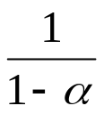
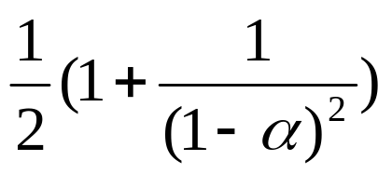
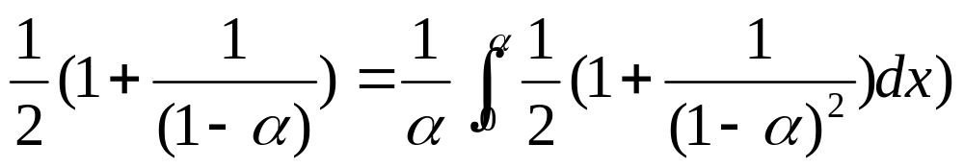
Linear Probing Analysis
For load factor α = n/N, the average number of cells that are examined in an insertion is:
  Assume independence of probes
  If an event occurs with probability p then, on average 1/p trials are required until the event occurs.
  The probability p of a cell being empty is
  p = 1 - α
What really happens: Primary Clustering
  Probes are not independent! So :
  The average number of cells that are examined in an insertion is
Search
  unsuccessful - same as insertion
  successful

Slide 18
Linear Probing
Example
i | k
0 | 322
1 | 161
2
3 | 808
4 | 786
5 | 900
6
7
8 | 767
9
10
11 | 471
12
13
14 | 336
15 | 912
16
17
18
19
20 | 319
21 | 250
22
i | k
0 | 322
1 | 161
2
3 | 808
4 | 786
5 | 900
6 | 257
7 | 812
8 | 767
9 | 256
10 | 700
11 | 471
12 | 449
13 | 762
14 | 336
15 | 912
16
17
18
19
20 | 319
21 | 250
22
f(k)=k mod 23
Insert:
Key Probes
257 4, 5, 6
449 12
812 7
256 3, 4, 5, 6, 7, 8, 9
700 10
762 3, 4, 5, 6, 7, 8, 9, …
10, 11, 12, 13

Slide 19
Quadratic Probing
If the current location is used, try progressively larger offsets into the table
Algorithm quadraticProbingInsertItem(h, itm):
Input: h is an array of size N
itm is an Item with a key and an element.
Output: None.
k = itm.key()
probe = f(k)
j = 1
while (h[probe] is occupied) do {
probe = (f(k) + (j*j) mod N) mod N
j=j + 1
}
h[probe] = itm

Slide 20

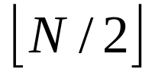
Quadratic Probing
If the load factor and N is prime, you can always find a location for the key and, for insertion, no cell is probed twice.
In fact, if N is prime, the first alternative locations are distinct. The probe is actually calculated as
probe = f(k)
probe =(probe + (2*j-1) mod n) mod n
(the mod is usually replaced by subtracting N)

Slide 21
Quadratic Probing
Example
i | k
0 | 322
1 | 161
2
3 | 808
4 | 786
5
6
7 | 900
8 | 767
9
10
11 | 471
12
13
14 | 336
15 | 912
16
17
18
19
20 | 319
21 | 250
22
i | k
0 | 322
1 | 161
2
3 | 808
4 | 786
5 | 257
6 | 762
7 | 900
8 | 767
9
10 | 700
11 | 471
12 | 449
13
14 | 336
15 | 912
16 | 812
17
18
19 | 256
20 | 319
21 | 250
22
f(k)=k mod 23
probe=(probe + (2j-1) mod n) mod n
Insert:
Key Probes
257 4, 5
449 12
812 7, 8, 11, 16
256 3, 4, 7, 12, 19
700 10
762 3, 4, 7, 12, 19, 5, 16, 6

Slide 22
Double Hashing
Use two hash functions
  f₁(k) = k mod N
  f₂(k) = q - (k mod q)
  N and q are prime, q < N.
  f₁(k) computes the primary location, f₂(k) computes the probe offset if the primary location is occupied.
  f2(k) ≠ 0

Slide 23
Double Hashing Insert Algorithm
  Algorithm doubleHashingInsertItem(h, itm):
  Input: h is an array of size N
  itm is an Item with a key and an element.
  Output: None.
  k hash(itm.key())
  probe = f₁(k)
  offset = f₂(k)
  while (h[probe] is occupied) do {
  probe = (probe + offset) mod N
  }
  h[probe] = itm

Slide 24
Double Hashing
Example
i | k
0 | 322
1
2
3 | 808
4 | 161
5
6 | 250
7 | 900
8 | 767
9 | 786
10
11 | 471
12
13
14 | 336
15 | 912
16
17
18
19
20 | 319
21
22
i | k
0 | 322
1
2
3 | 808
4 | 161
5 | 762
6 | 250
7 | 900
8 | 767
9 | 786
10 | 700
11 | 471
12 | 449
13
14 | 336
15 | 912
16
17 | 812
18 | 257
19 | 256
20 | 319
21
22
f₁(k)=k mod 23
f₂(k)=11 - (k mod 11)
probe = f₁(k)
probe = (probe + f2(k)) mod 23
Insert:
Key Probes
257 4, 11, 18
449 12
812 7, 12, 17
256 3, 11, 19
700 10
762 3, 11, 19, 4, 12, 20, 5

Slide 25
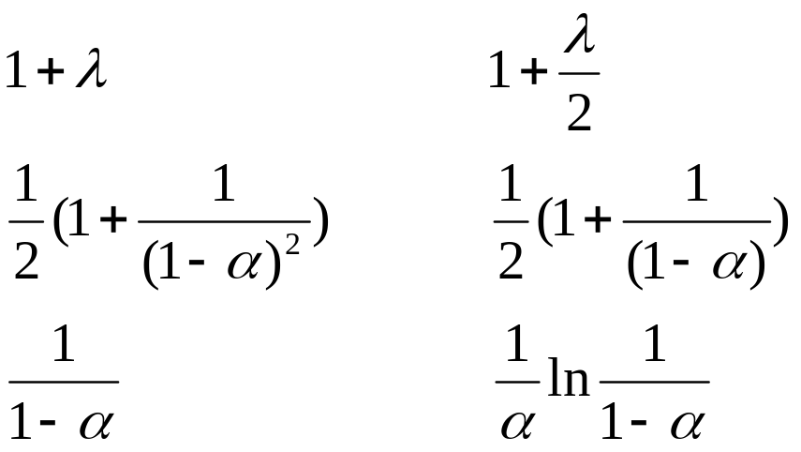
More Theoretical Results
Number of probes depends on the load factor, α
Chaining:
  unlike linear/quadratic probing or double hashing, chaining does not require α to be bound by 1.
  if average linked list is of length λ, then:
  not found found
  Chaining
  Linear probing
  Double Hashing

